Slide 1
Prediction of Conversion Status
By Gargi Goswami(A21039)

Slide 2

Objectives: The objective is to build a Logistic Regression model to predict that the online users of a retail sports merchandise website are ultimately bought the product or not (conversion status)

Slide 3
Business Problem:
Now a days in this COVID situation customers mostly like to shop by online mode. Retail Companies must try to look after this and try to increase the revenue.

Slide 4
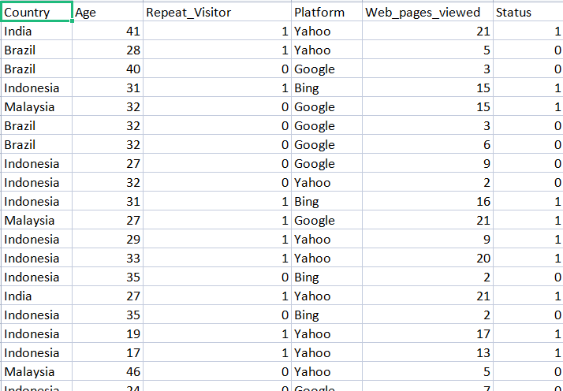
DATA DESCRIPTION:

Slide 5
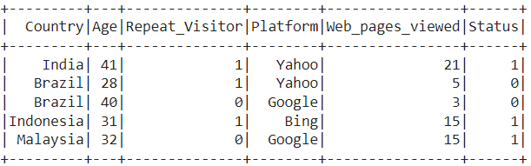
Basic EDA:
To understand the data set and gather information about data.

Slide 6
Visualization:
To understand the relationship between the variables visualization is very much important.
Bar chart for Platform vs Web_Pages_Viewed
Bar chart for Age vs Web_Pages_Viewed

Slide 7
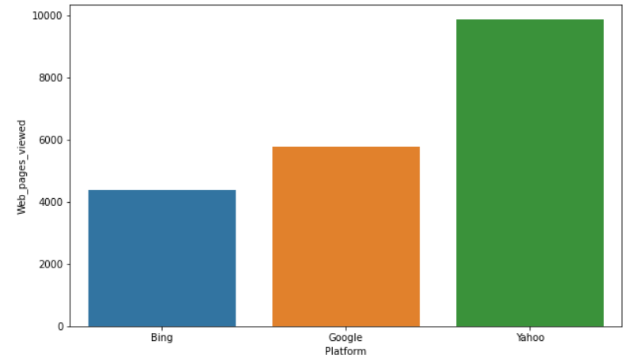
BAR-Plot :

Slide 8
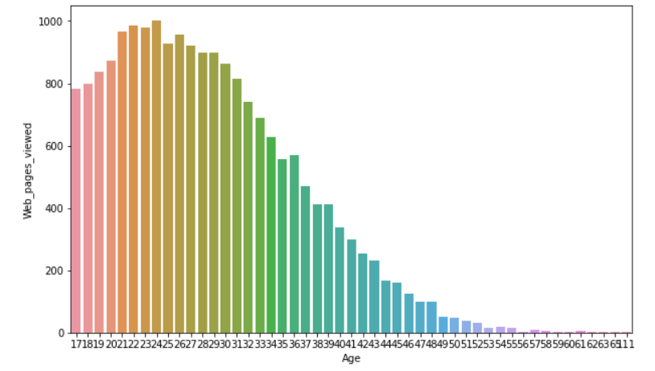
BAR-Plot :

Slide 9
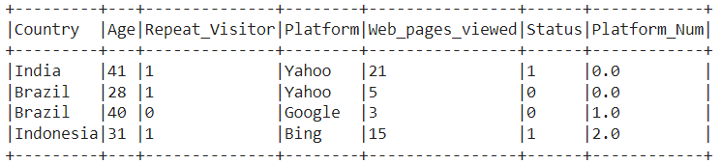
Feature Engineering:
Feature Engineering is essential to convert the categorical variables into numerical variables and create a single vector by combining all the input features with the help of Spark’s Vector Assembler.

Slide 10
Splitting The DATA SET:
Split the dataset into a training and test dataset in order to train and evaluate the performance of the logistic regression model. I split it in a 75/25 ratio and train our model on 75% of the dataset.

Slide 11
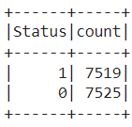
Training Set:

Slide 12
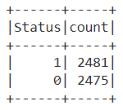
Test Set :

Slide 13
Build and Train Logistic Regression Model:
I build and train the logistic regression model using features as the input column and status as the output column.

Slide 14
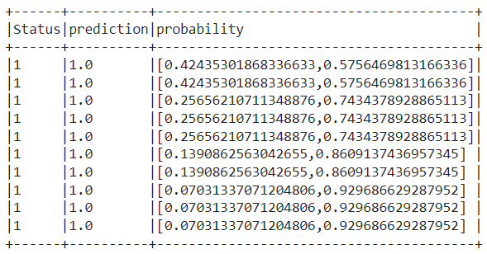
Training Results:
I can now access the predictions made by the model using the evaluate function in SPARK that executes all the steps in an optimized way. It gives another Data frame that contains four columns in total, including prediction and probability.

Slide 15
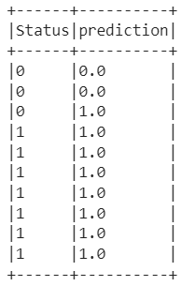
Evaluate Logistic Regression Model on Test Data :
Now check the performance of the model on test data. So the evaluate function is used, to make predictions on the test data.

Slide 16
Confusion Matrix :
As this is a classification problem, I use a confusion matrix to gauge the performance of the model.

Slide 17

Accuracy :
It is the most basic metric for evaluating any classifier.

Slide 18

Recall :
Recall rate shows how much of the positive class cases we are able to predict correctly out of the total positive class observations.

Slide 19

Precision :
Precision rate talks about the number of true positives predicted correctly out of all the predicted positives observations.

Slide 20
Conclusion :
So, the recall rate and precision rate are also in the same range, which is due to the fact that our target class was well balanced. It means my model is good to predict Conversion Status.

